Slide 1
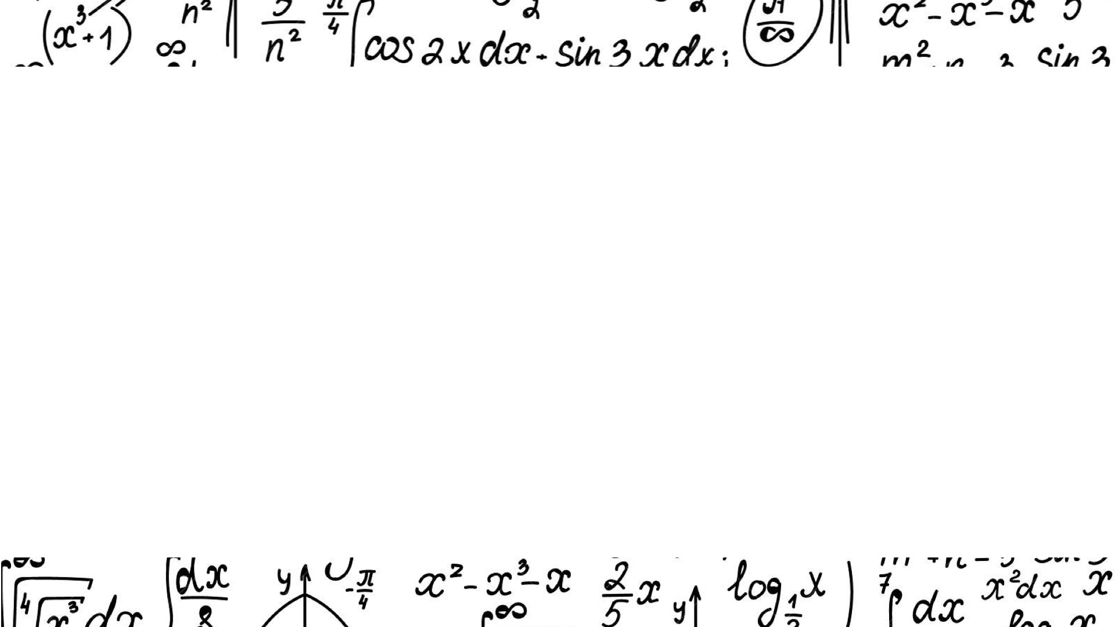
Classifying Handwritten Math Symbols
Bianca Orozco
Notes:
Good afternoon
my name
thank you for being here
As a lifelong mathematician I know how tedious to type equations
Many would say mathematicians are averse to tech
I would argue
For this reason, I decided to focus my final project

Slide 2

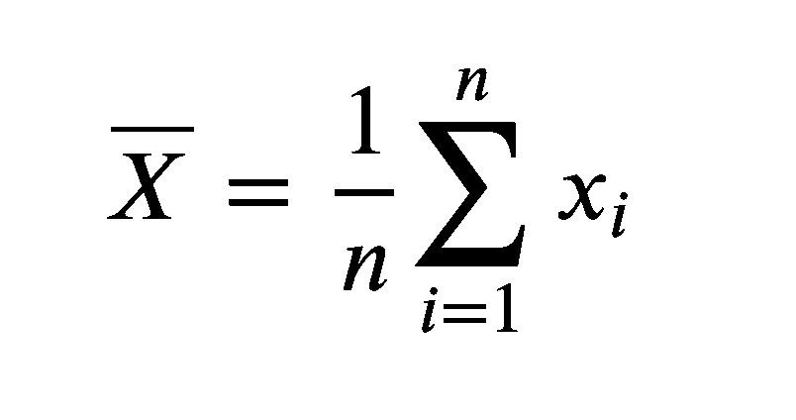

LaTeX

Slide 3

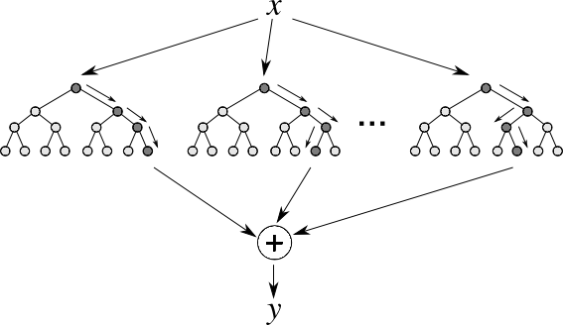




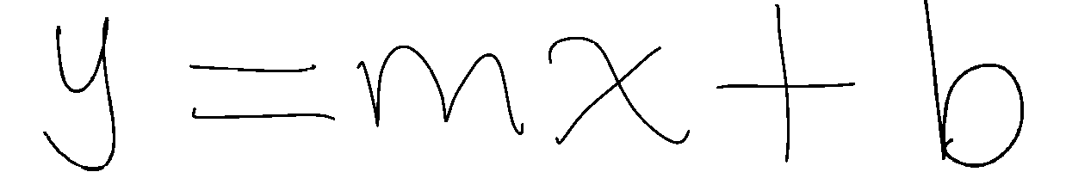
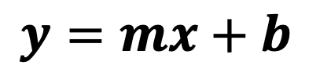
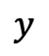
Methodology
Handwritten Symbol
$$y$$
$$y=mx+b$$
Accuracy Score: 0.75
Handwritten Equation
Text Equation
Kaggle Dataset
Metric
Predicted Symbol
Random Forest Classifier
Random Forest Classifier
Notes:
In order to do this, I received my dataset from Kaggle
which consisted of thousands of handwritten math symbol images
After much data cleaning, balancing, and restructuring
I was able to use this data to train my Random Forest Model
I then tested this model by using the Notes app in my phone
Now I'd like to show you a demonstration of this
random forest diagram

Slide 4
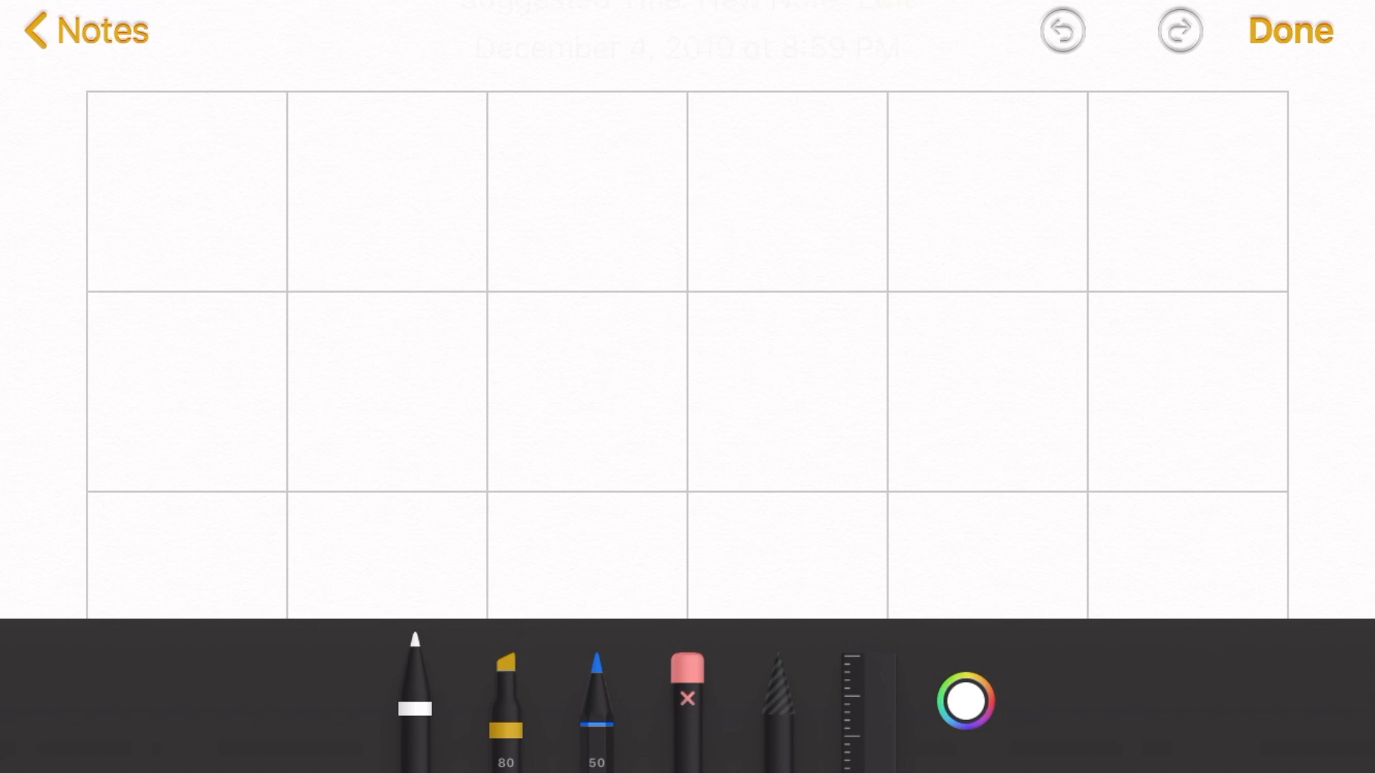
Demonstration
Success!!!

Slide 5
Uses and Next Steps
Equation writing app + LaTeX/Word
Variety of writing styles and math symbols
Notes:
This could serve as a base model for an equation writing application
work with LaTeX, for the Academic
or Word, for the everyday educator
with the tablet and smart pen functionality we h

Slide 6
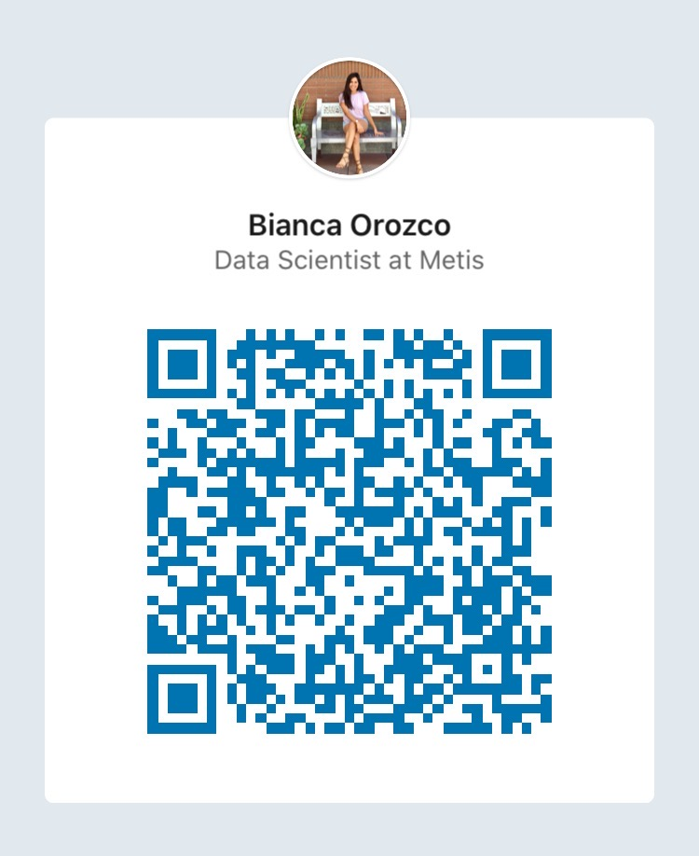




Thank You
biancaorozco
biorozco3
biorozco3
biorozco3@gmail.com
Notes:
I’d love to connect with you to talk about Call to action!

